Slide 1
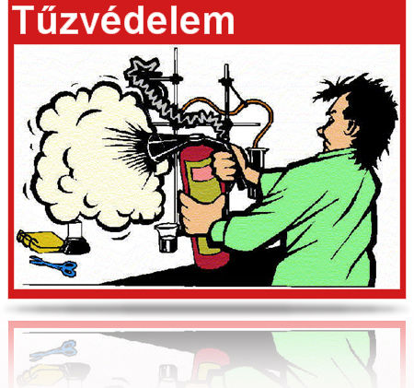
Fire protection training material 2015.

Slide 2
Legal background
Fire protection regulatory regime (key elements):
Act XXXI of 1996 on fire protection, technical rescue and fire brigades,
Ministerial Decree 54/2014. (XII.5) BM on National Fire Protection Rules,
Ministerial Decree 30/1996 (XII.6.) BM on the preparation of the fire protection rules
Facility fire protection policy;
Fire alarm plan,
General information:
In addition to compliance with fire protection rules, all employees and students shall:
be familiar with the use of fire extinguishers and fire detection equipment;
attend the annual fire protection training;
in the event of fire, attempt to extinguish the fire using the fire extinguisher(s);
report any fire extinguished without human intervention;
report any non-compliance to the superior or instructor;
upon the completion of work, check to make sure that the work area poses no hazard.

Slide 3
I. General rules of use
Rooms may only be used for their intended purpose.
Every day, combustible material collected from a room or machine must be transferred to the waste storage facility.
During operation, the doors of rooms with people inside MUST NOT be locked.
The keys to locked doors are to be kept at the reception desk to ensure easy access.
No materials in the explosive hazard category may be taken to or stored at university premises.
During and after work, compliance with fire protection usage rules at work stations must be verified, and any violation of those rules must be eliminated.
Employees violating fire protection rules may be held accountable (fined by the fire department).

Slide 4
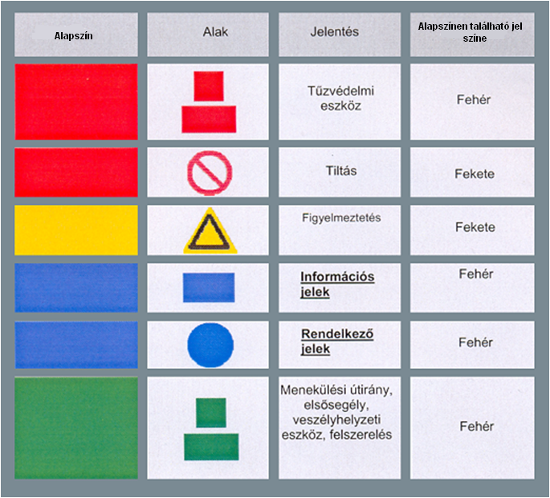
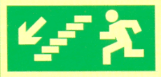
Safety signs:
The safety signs used enable workers and other persons in the effective range of the work to identify threats, fire protection and occupational safety and health equipment.
Background colour
Shape
Meaning
Colour of sign on background colour
Fire protection equipment
White
Prohibition
Black
Warning
Black
Information signs
White
Operative signs
White
Evacuation path, first aid, emergency equipment, gear
White

Slide 5
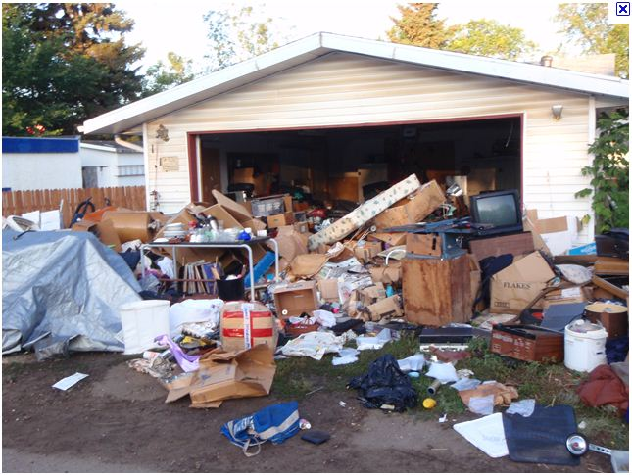
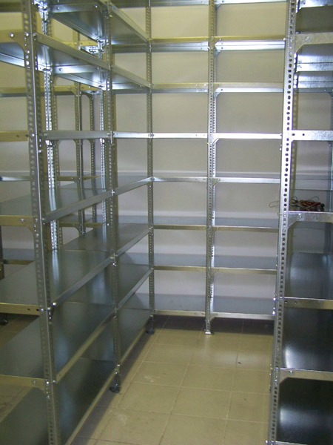
II. Stocking and storing
In the case of permanent stock, materials must be stored on racks, in cabinets or in boxes grouped by their hazard level and type.
No smoking and no work with thermal effects may be conducted, nor any open flames or electric kettles used, in the storage facility.
In the storeroom, a fire safety clearance of at least 1 metre must be kept between any flammable ceiling or roofing and the stored flammable material.
The stocking and storage area must be cleaned of flammable waste, dry vegetation, etc. on a regular basis.
Entry and exit points and traffic routes in storerooms may not be restricted or blocked, even temporarily.

Slide 6
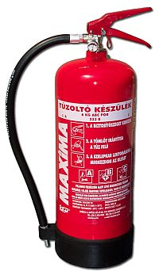
III. Fire-extinguishers and their labelling
A minimum of one standard fire extinguisher (or, in special cases stipulated by law, a type designated by the National Fire Protection Rules) is available on every floor of facilities and independent functional units. The number of fire extinguishers and the unit numbers of other extinguishing agents comply with the provisions of the relevant legislation.
Fire fighting technical devices and equipment must be installed in a visible, easily accessible location near the endangered areas and must be kept in a condition ready to operate at all times. These units may not be removed from their installation locations or used for any unintended purpose.
Any unit that is faulty or not suitable for extinguishing a fire breaking out in the facility (room) must be replaced.
Important note: Absolutely no water may be used to extinguish electrical fires. Prior to using a fire extinguisher, disconnect electrical equipment to avoid electric shock.

Slide 7
How does one use a fire extinguisher?
The fire extinguishers on standby are operated by a propellant gas. It means that the cylinder is under static pressure of approx. 14 bar. There is a handle on the top of the cylinder, with the operating lever attached, which you can activate by removing the safety pin and pushing the lever to discharge the agent. Of course, use the other hand to aim the hose toward the fire.
Important: Whatever unit you use, do not operate it continuously, but rather in small bursts to make fire fighting more effective.
What is the correct distance from the fire to use an extinguisher?
The effective range of an extinguisher using 1 kg of dry chemical agent is 1 meter. Those with 2 or 3 kg of agent can be used from 2 meters, the ones with 6 or 12 kg of agent from 3 meters. All fire extinguishers operate for approx. 10 seconds.
With the exception of CO2 extinguishers, all units have similar parameters.
When you use a CO2 unit, you need to move much closer to the fire, because the gas evaporates very quickly. Another key piece of information to remember is to use only the structural units designed for handling. The CO2 is discharged from the unit at approx. –78 °C, which can cause severe frostbite.

Slide 8
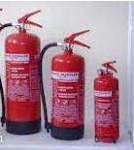
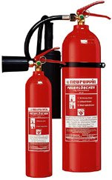
12, 6 and 2 kg dry chemical extinguishers:
2 and 5 kg CO₂ extinguishers:

Slide 9
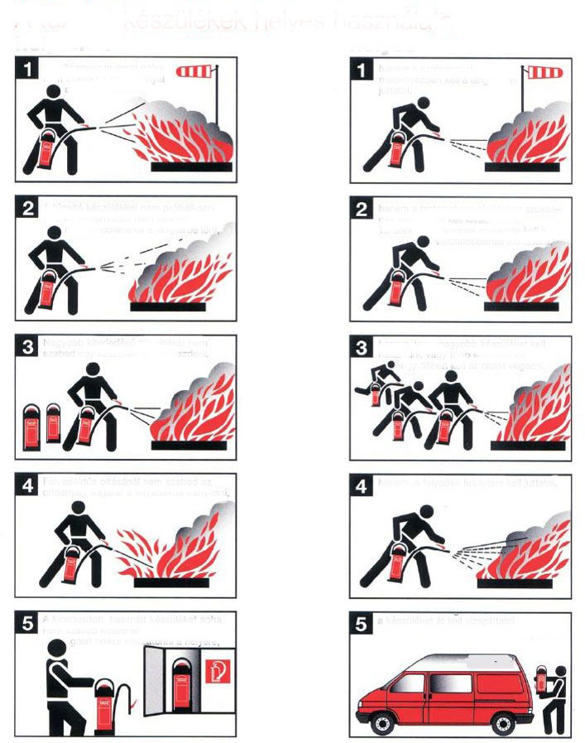
Correct use of fire extinguishers:
incorrect
correct
The extinguishing agent must never be discharged upwind,
but discharge it at the base of the flame downwind.
Do not try this with the fire extinguisher. The extinguishing agent must not be carelessly discharged into the flame,
but select the unit that can safely extinguish the fire. Keep some of the extinguishing agent in reserve to put out any secondary flames.
Do not attempt to extinguish a large fire with a single extinguisher,
but use a larger unit, or several persons must start fire extinguishing at the same time.
In the case of a liquid fire, do not direct the extinguishing jet into the liquid,
but discharge on the surface of the liquid.
Do not leave the unit without a safety pin, or that has been used on standby, in its installation location
without inspection,
you must have the extinguisher inspected.

Slide 10
IV. What to do in case of a fire?
When the fire alarm goes off, everyone must leave the room immediately;
if possible, lock up or take your valuables with you, and lock your computer. However, do not lock rooms and offices, but leave the keys in the doors.
The evacuation period available for the building is 6 minutes, even from its most distant point.
Everyone must approach the exit using the stairs closest to their current location.
DO NOT use the elevators in the event of a fire.
Do not enter the facility in the event of a fire. You may return to the building only with the permission of the person leading the fire fighting.
Those who exit the building must stay in the street in front of the building until a competent person grants permission to return to the building.
Safe evacuation of the building is coordinated with the authorized and responsible colleagues and superiors, during which time due care must be exercised to avoid any accidents.

Slide 11
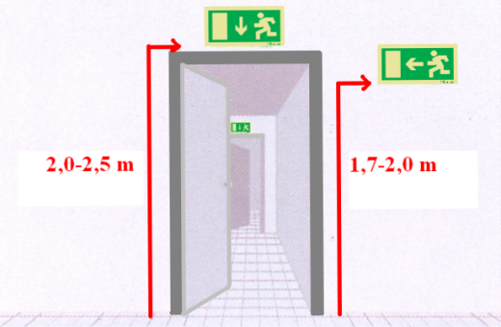
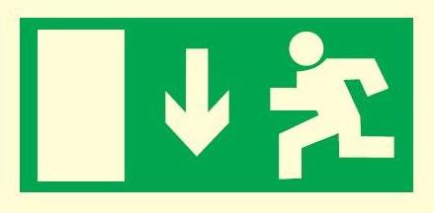
V. Labeling of escape routes
The signs are self-explanatory:
Fast and safe navigation within the building for those involved in rescue operations is provided by phosphorescent or illuminated safety signs marking escape routes.
An escape direction marking system in compliance with the relevant standard is installed along evacuation routes, at exits, emergency exits and at door of rooms opening to escape routes, to provide continuous and consistent visual information on the direction of evacuation along the entire escape route.
Access to the switch for any electrical installation, the unlocking and locking device for any public utility, the manual fire alarm bell, any fire protection equipment or fire extinguisher must not be blocked and passageways, doors, and evacuation routes must not be restricted even temporarily.
Traffic routes and doors used for evacuation must remain fully accessible at all times and must not be blocked or restricted even temporarily.

Slide 12
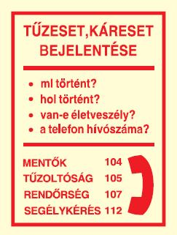
VI. What to do in case of a fire?
If necessary, inform all employees and students in the building, evacuate any injured persons, immediately evacuate the building to a rally point.
When reporting a fire to the fire department (emergency number: 105), always include the following information:
the exact location of the fire or damage (office, storeroom, computer room, hallway within the building)
the source of fire (e.g. storeroom, office),
what is burning, what is in danger (paper, furniture)
is human life in danger,
the extent of the fire and the amount of combustible material,
the name of the person reporting the event,
the telephone number used to report the fire.
The site of any fire must be left in its original state until the fire investigation is complete.
Fire alarm may occur via
a manual fire alarm,
automatic fire detection units;
fire alarm over the phone
Any fire must be reported to the
Facility reception desk (+36-1-462-4600).

Slide 13
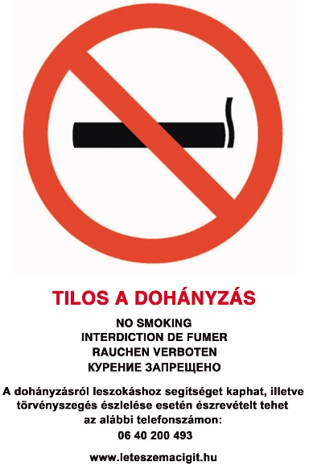
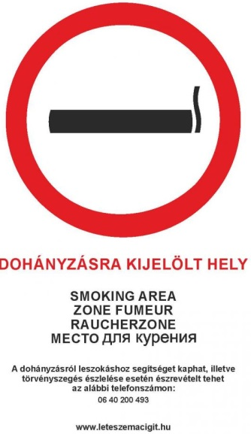
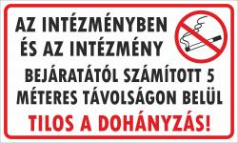
VII. Information related to smoking
NO SMOKING in enclosed university places.
The act on the protection of non-smokers was amended in 2011. The amendment prohibited smoking in enclosed workplaces. Accordingly, smoking at work is only allowed outdoors, at least 5 meters from the entrance of the institute.
Smoking is permitted only at designated places.
Marking:

Slide 14
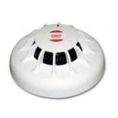
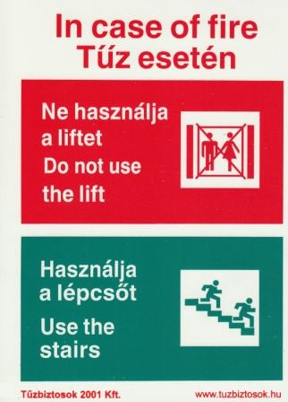
Intelligent Fire Detection Centre and its equipment
Fire Alarm Centre, marking:
The building is equipped with a comprehensive protection system for human lives and material assets capable of early fire detection, alarm and supporting fast evacuation of the building after the fire alarm is activated.
Sensors:
Optical smoke detector:
Mounted on the ceiling or the highest point of the room, the optical smoke detector detects smoke before fire starts and sends a signal to the fire alarm centre.
Heat flow sensor:
Heat flow sensors are installed at places where, due to operations, there is often smoke (e.g. kitchens). Heat flow sensors disregard smoke but they immediately activate the alarm in the event of a sudden increase in temperature.
Elevators:
In case of fire, the controller unit in the fire detection system sends all elevators to the ground floor.

Slide 15
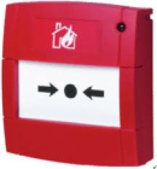
Manual fire alarms and their labeling and functions in short:
In case of fire, these manually activated units send a fire alarm signal to the Fire Alarm Centre.
The manual fire alarm may only be operated by braking a cover glass or by pushing in a Plexiglas panel.
Automatic fire detection systems operate at the following locations:
Liszt Academy – 1061 Budapest, Liszt Ferenc tér 8.
György Ligeti Building – 1077 Budapest, Wesselényi u. 52.
Partial fire detection system operating at:
Old Academy of Music – 1064 Budapest Vörösmarty u. 35.
No automatic fire detection system operates at the following location:
Semmelweis Street building – 1052 Budapest, Semmelweis u. 12.,
Béla Bartók Music Secondary Grammar School and Technical School – 1065 Budapest, Nagymező u. 1.
Béla Bartók Dormitory – 1071 Budapest, Városligeti fasor 33.
The fire alarm signals with the yard bell and intermittent sounds from a manual bell.

Slide 16
Fire protection training
Employees and students must familiarize themselves and comply with the preventive fire protection regulations, instructions and provisions relevant to their workplace, activity and service station.
In compliance with the relevant legislation, fire protection training must be administered to employees upon hiring and students at the start of their academic programme.
Appropriate action must be taken to ensure such training to employees and students in the workplace. Repeated fire protection training must be provided as needed, but at least once a year.
The tasks related to the organization of repeated trainings are listed in the Fire Protection Policy.
Fire protection training must be provided during regular working hours and repeated trainings, if possible, in occupational groups. Participation in the training must be registered by the employee signing the attendance sheet.
Within 3 workdays from their date of hire, a make-up training must be administered to employees who did not attend the primary fire protection training and their participation must be recorded in the training log.

Slide 17
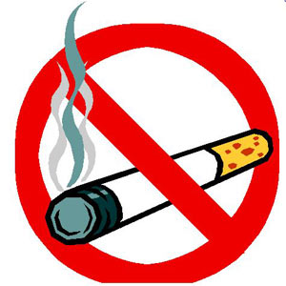
Fire prevention
In order to minimize fire risk, here are a few thoughts about prevention:
Before disposing of a match or cigarette, make sure to put it out first.
Do not throw away a burning match or a lit cigarette at a location where it can cause fire.
No activities involving naked flame (not even candles) are permitted on University premises.
Electrical heat-generating appliances must not be left unattended when switched on.
Heat generating appliances (hot plate, toaster, etc.) may only be used on non-combustible pads.
Electrical appliances must be switched off when leaving the room.
No smoking or naked flame in classrooms and libraries.
Faulty electrical appliances must not be operated.
No custom heat-generating appliances may be used in classrooms, offices and dorm rooms.
Electrical equipment and appliances may only be repaired by qualified and authorized technicians.

Slide 18
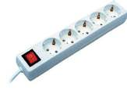
Fire protection rules for offices and classrooms
Office furniture must be arranged to allow free movement and to allow doors to be opened to their full width.
Each room must be equipped with an appropriate number of waste bins and those must be emptied as needed, but at least after work is completed.
Combustible materials may be stored in rooms only in quantities absolutely necessary for continuous operation.
Materials and fluids posing an explosive hazard must not be stored in rooms in any quantities.
Documents must be regularly sent OT the archives.
Office equipment may only be operated in compliance with the operating manual.
No damaged electric equipment, extension cords, adapters, etc. may be used.
Electrical appliances must be powered down after work is complete.
It is the responsibility of the person leaving the room last to turn off all electrical consumer units.

Slide 19
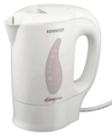
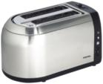
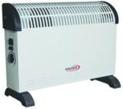
Kitchenette fire protection rules
All equipment and appliances must be positioned to keep all traffic routes free.
Dirt collected on appliances must be regularly removed but at least once a day.
Appliances may only be used as described in the user manual.
Prior to locking up, the kitchenette must be checked for any fire hazard and to ensure all appliances are switched off.
Activities with a fire risk may only be conducted in the kitchenette with written authorization.
Prior to use, the coffee-maker and the electrical hotplate must be placed on an insulation pad made of non-combustible material. These appliances must not be left unattended when switched on.

Slide 20
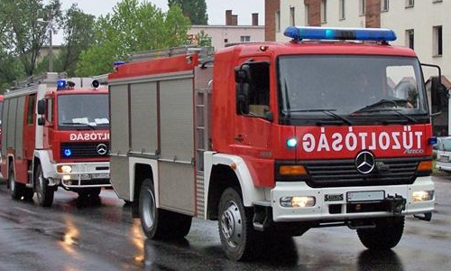
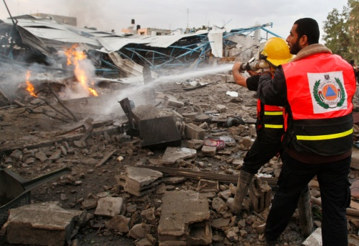
Fire protection fine
Non-compliance with fire protection rules may result in a fine imposed by the fire protection authority based on Government Decree 259/2011 (XII.7.).
The following mandatory fire protection fines shall apply:
Violation of fire protection rule resulting in a fire (HUF 100,000–1,000,000)
Violation of fire protection rule resulting in a fire and the fire department had to be involved to extinguish the fire (HUF 200,000–3,000,000)
Violation of fire protection rule that resulted in a direct threat of fire or explosion (HUF 100,000–1,000,000)
Restriction of evacuation exit or emergency exit preventing the throughput needed upon evacuation, (HUF 30,000–45,000 per exit)
Blocking or restricting evacuation exit or emergency exit in a way that cannot be eliminated immediately (HUF 200,000–300,000 per exit)

Slide 21
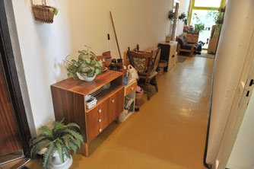
Fire protection fine
Storing combustible materials and objects in a passage or hallway used as part of the evacuation route without authorization from the authority (HUF 60,000–100,000 per hallway)
Hindering intervention by the fire department (HUF 30,000–2,000,000)
If the employer failed to arrange for fire protection training or, if the employer is obligated to have its own fire protection policy, failed to provide the fire protection policy for information in a verifiable manner to new employees within 15 days from the date their employment commences (HUF 100,000 per employee)
If the employer failed to provide a repeated or extraordinary fire protection training required for employees by the fire protection authority in a verifiable manner or failed to provide the fire protection policy for information to employees by the deadline stipulated in the fire protection policy or the authority’s decision in that regard and more than 15 days passed since the above deadline (HUF 100,000 per employee)

Slide 22
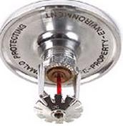
Fire protection devices and equipment
The fire protection devices and equipment in standby at the University and their methods of fire signalling are detailed in the following table:
Equipment | Equipment marking | Zeneaka- démia Liszt F. tér 8. | György Ligeti Building Wesselényi utca 52. | Béla Bartók Dormitory Városligeti fasor 33. | Old Academy of Music Vörösmarty u. 35 | Béla Bartók Secondary School and Technical School Nagymező utca 1. | Semmelweis Street Building Semmelweis utca 12. | Kodály Institute Kecskemét
Manual fire extinguisher
evacuation route signs |  |  |  |  | Partially imple-mented. | Partially imple-mented.
Integrated automatic fire extinguisher system
Integrated automatic fire detection system |  |  |  |  |  | No automatic fire alarm. The fire alarm is signalled by manually sounding the bell! | No automatic fire alarm. The fire alarm signal is by the yard bell.
Wall-mounted fire hydrant

