Slide 1
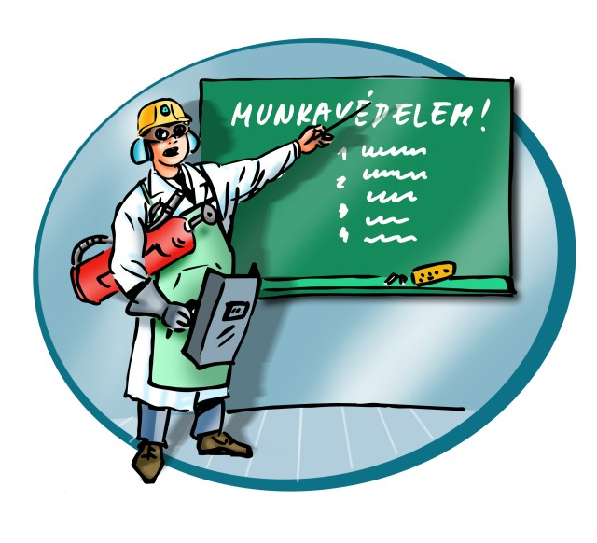
Occupational safety and health training material 2015

Slide 2
Legal background
The purpose of occupational safety and health:
To protect the health, safety and working ability of those conducting organized work, to prevent accidents and to provide humane working conditions.
Achieving this goal is supported by the following legislative background:
The Fundamental Law of Hungary
Act XCIII of 1993 on Labour Safety (LSA);
Ministerial Decree No. 5/1993 (XII.26.) MüM on the implementation of the act;
government decrees, decrees issued by the minster responsible for employment policy and health on the management of occupational safety and health, and decrees issued by ministers relevant to the activity (sector);
Standards
employer’s occupational safety and health regulations (rules on personal protective equipment, health and safety policy, method statements, operating instructions)

Slide 3
Definitions
Organized employment: work performed in an employment relationship, in the legal relationship of public service and public employment, in the service relationship of a judge or a prosecutor, in the legal relationship of employment in the case of cooperative membership, in the framework of students' legal relationship in vocational schools while carrying out the requirements of their professional training as well as practical training on the basis of a contract.
Employer: the entity who hires employees for organized employment.
Employee: a person who performs work within the framework of organized employment.
Workplace: all outdoor or indoor (enclosed) spaces where employees are situated for the purpose of or in connection with the performance of work.
Occupational disease: chronic damage to health that occurs during work or employment or results from such activities.
Occupational accident: an accident suffered at work by a worker while directly or indirectly involved in organized employment.
Commuting accident: an accident suffered by the worker while travelling from their quarters to the workplace or back. An accident suffered in the employer’s own or leased vehicle does not qualify as a commuting accident.
Computer work station: a sum of all work equipment including a screen (visual display unit), input device (keyboard, scanner, camera, etc.), other peripheral devices (pointer, printer, disk drive, modem, etc.), any accessory, any software based on human-machine interaction, folder, work chair, work desk or work surface, phone or direct work environment.

Slide 4
The three core principles of occupational safety and health
I.
Employees and students must be familiar with the occupational safety and health rules and conduct of their work activities accordingly. They may not expose themselves to any hazardous situation. If they cannot eliminate a hazardous or irregular situation, they must report it to their superiors!
II.
If employees/students notice non-compliance behaviour by any of their colleagues/peer students or that such persons are in an emergency situation, they must warn them. If the emergency situation persists, they must report it to their superiors.
III.
If one of your colleagues warns you or another colleague of non-compliance with the occupational safety and health rules during work activities, or that there is an emergency situation, you must change your behaviour to eliminate the irregular or hazardous situation. If you cannot eliminate the hazardous or irregular situation, you must report it to your superiors.

Slide 5
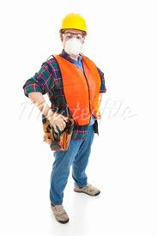
Personnel conditions of work
Professional qualifications
Medical fitness
Participation in trainings
Shows up for work in a condition suitable to perform duties
(not under the influence of alcohol, well-rested,
not under any harmful influence of drugs, etc.)

Slide 6
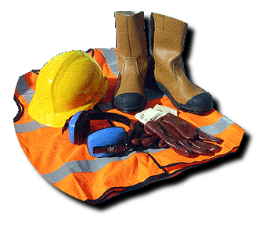
Material conditions of work
The equipment used for work is safe and suitable for its intended purpose.
No accident caused to those near the work site (e.g. clients)
The environmental conditions must be appropriate to the work (illumination, temperature, etc.).

Slide 7
Rights and responsibilities of the employee
The employee shall:
Comply with the requirements to show up for work in good condition, ready to start work and conduct work activities.
Attend the health and safety and other trainings offering vocational know-how.
Comply with work instructions and other verbal or written instructions given by the employer.
Attend the pre-employment and periodic medical examinations and those they are assigned to.
Wear appropriate clothing and the personal protective equipment provided to them.
Check the immediate work area and work equipment for safety.
Report any hazard or hazardous situation identified or learned of to their immediate superior.
Report any work accident or distress to their immediate superior.
The employee has a right to:
Safe working conditions, work stations and work equipment.
Knowledge regarding safe working.
Equipment, work and personal protective equipment needed for health and safety.

Slide 8
Actions required in the event of an occupational accident
FIRST AID
Treating wounds, haemostasis (using the first aid kit)
Call a doctor/ambulance.
Drive to the hospital (if needed)
Apply resuscitation (For qualified personnel only!)
REPORTING ACCIDENTS
All injuries and sicknesses must be reported to the immediate superior at work.
All injuries must be recorded in the injury log at the workplace.
If the accident results in any workday lost, the accident must be investigated and recorded. The reasons must be explored and appropriate measures must be taken for the purpose of prevention.
If any workday is lost due to an occupational accident, it must be reported to the health and safety service provider.
ACCIDENT INVESTIGATION
Assessment of the accident as a work or factory accident.
Hearing of witnesses.
Discovering all relevant issues, direct and indirect reasons.
TAKING PREVENTIVE MEASURES

Slide 9
Reporting accidents
Ambulance phone number: 104
When calling, the caller must state:
WHAT HAPPENED
THE NUMBER OF PEOPLE INJURED
CLEAR DIRECTIONS TO THE SCENE
MEANS OF ACCESS TO THE SCENE
NAME, ADDRESS AND PHONE NUMBER TO CALL BACK
If possible, the caller should provide information about the circumstances and the severity of the accident.
If the accident site is not well-known, name a landmark and send someone there to wait for the ambulance to arrive.
In the event of an accident on University premises, always inform the immediate supervisor and Attila Gáti, Head of the Operating Department.
All designated first aid points are equipped with first aid kits in sufficient number and with sufficient content.

Slide 10
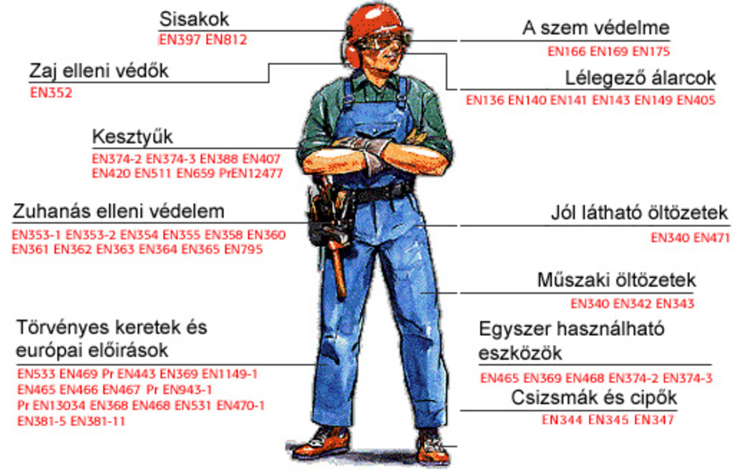
Personal protective equipment
Respirators
Hand protectors
Foot protectors
Hearing protectors
Eye protectors
Head protectors, etc.
When not in use, protective gear must be stored appropriately.
Personal protective equipment items have no expiration dates. If they fail, they must be replaced.
The required personal protective equipment must be worn and used for the full duration of work.
Helmets
Eye protection
Noise protection
Respiratory masks
Gloves
Protection against falling
High visibility wear
Technical wear
Legislative framework and European regulatory requirements
Disposable equipment
Boots and shoes

Slide 11
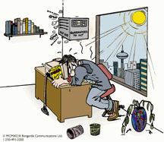
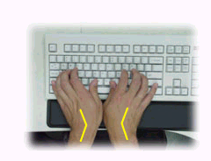
Safety of computer work stations
Key health risk factors of working at a work station with a visual display unit:
Factors causing deteriorating eyesight (hidden fault related to refraction of light, lack of comfortable binocular vision)
Psychological (mental) factors. (neural fatigue)
Factors causing deterioration of physical state (e.g. hand, arm and spinal pain)
Requirements for work equipment:
Screen:
Stable image (no flickers, elimination of any instability)
Adjustable brightness and contrast.
Swinging and tilting monitor.
Anti-glare screen.
Keyboard:
Separate from the monitor.
Tilting option for ergonomic work position.
Sufficient room in front of the keyboard to support the hands and the wrists.
Matte surface to avoid glare.
Keyboard symbols are easy to differentiate and read.

Slide 12
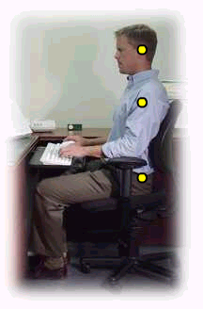
Work desk, work surface:
Size appropriate to the specific task:
Flexible fitting for the task.
No light reflecting surface.
Stable, free from any wobbling.
Adjustable height, if possible (generally 720 mm)
Work chair:
Stability.
Easily adjustable seat pan.
Tilting backrest with adjustable height.
If needed, sole and arm rest.
Light, without obstructing free movement.
Maneuvering space:
at least 2 m² of free space to ensure free movement at the work station.
Safe approach to other equipment.

Slide 13
Climate control, the rules for intellectual work while seated in an office apply:
Cold season: 20–22 °C
Warm season: 21–24 °C
Airflow speed: max. 0.1 m/s
Software ergonomics, man machine interaction:
Suitable for the specific job.
Adjustable to computer literacy and experience level.
Hungarian language assistance.
No qualitative or quantitative control of worker performance is permitted without informing the workers.
The systems must provide information in a format and at a rate suitable for the person working in front of the screen.

Slide 14
Working with computer screens is regulated by Ministerial Decree 50/1999 (XI.3.) EüM.
The decree stipulates that for the sake of safety and health at work:
At every hour, a 10-minute break must interrupt the worker’s viewing of the screen (phone call, faxing, reading or printed material) with some exercising, if possible. A maximum of 6 hours may be spent working in front of the screen, which must be ensured by workers at their own risk and own work organization.
Vision tests for workers must be ensured and workers must be sent to an eye exam as needed
but at least every other year.
The employer shall provide workers at computer work stations with glasses offering 20/20 vision,
under the following conditions:
Justified by an optometrist’s exam.
The glasses or contact lenses used by the worker are not appropriate for work in front of the screen.

Slide 15
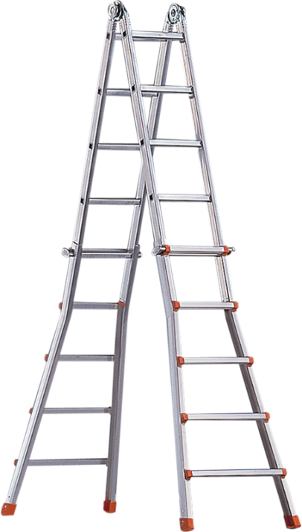
General health, cleanliness and occupational safety and requirements of university workplaces
Order and cleanliness must be ordered at all university work stations.
All unnecessary objects must be removed from the site that would limit the worker’s free movement and could cause any injury.
Work stations must be cleaned regularly but at least once a day.
The workplace shall be kept in good order and clean, in accordance with the nature of the work, and the handling of pollutants, sewage and solid waste material shall be provided for in a manner to prevent such from causing any danger or health injury, or any damage to the environment..
Except for the designated (outdoor) smoking areas, smoking is not permitted on university premises.
All ladders and mobile stairs must be safe, suitable for the specified purpose and load, in good condition and secured against slipping and tilting.
After the completion of work activities, the workplace must be inspected for any circumstances that may cause fire, explosion or flooding when the site is unattended.

Slide 16
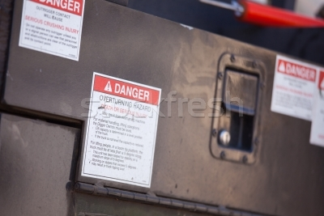
Information related to electricity
Most work stations operate with electricity supplied by the 400/230 V AC grid.
As part of a closed electric circuit, the human body is a good conductor.
External electricity circulating through our bodies is very dangerous because our vital organs (lungs, heart) are operated by our brain via tiny bioelectrical circuits, which can be paralyzed by electrical current.
Electrical shock, however can be easily and safety avoided by exercising due care.

Slide 17
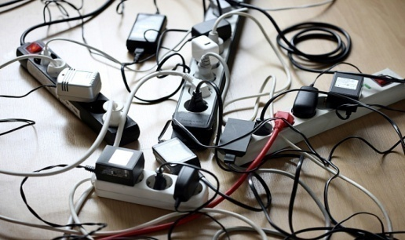
Information related to electricity
Electrical current can pass through the human body in one of two ways:
You touch a bare conductor (current phase) and the neutral conductor or a machine with a protective conductor or device, or a conductive floor at the same time.
Key aspects of protection:
Do not use any faulty, broken or damaged equipment.
Do not use the equipment if the power cable is ruptured, the insulation is cracked or the cable is damaged.
Do not touch any earthed metal object when using an electric device. Whenever possible, insulate your body from the ground.
Extensions to or modifications of the power cable may only be carried out by qualified personnel.
Even the simplest operations (e.g. replacing a bulb or a fuse) must be completed by first switching off and isolating the specified equipment.
Thus, shock protection is up to the person involved and only careful behaviour can avoid electric shock.

Slide 18
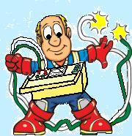
The metal housing of electrical equipment or devices may unexpectedly become energized due to some fault (e.g. broken insulation).
Upon unexpected fault of inner factory insulation (aged, worn out, broken, etc.), the phase conductor inside suddenly comes into contact with the metal body of the equipment, which is called a short-circuit to earth. As a result, the working parts of the equipment may become energized and dangerous phase conductors.
This risk can be eliminated by regular shock protection inspections.

Slide 19
Violation of health and safety rules
In addition to banning from work, infringement proceedings may be initiated against the worker for violating the rules on occupational safety and health.
A person who fails to report or inspect an accident commits an act of negligence,for which they are held responsible under labour law regulations.

Slide 20
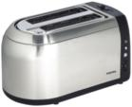
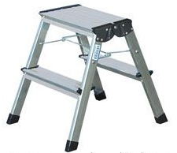
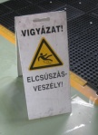
Lessons from occupational accidents
Absolutely no kettle or coffee-maker of any type is permitted in offices or dorm rooms. The rooms suitable for the use of heat generating devices and the rules for using such equipment are determined by the Operating Department.
Only ladders in perfect working order may be used for work and only for their intended purpose. The person using the ladder must hold on to something stable with one hand and ensure that the platform of the ladder is stable.
In sanitary units, kitchenettes and on wet floors always take into account the risk of slipping. Always use a warning sign with mopped or temporarily wet floors and, if necessary, designate a detour.

Slide 21
Summary.
Most accidents and injuries are caused by fatigue.
Fatigue and injuries are caused by:
insufficient oxygen supply to the muscles
overstrained muscles
Two key principles of prevention:
Watch your posture when working and always try to assume a neutral posture.
Alternate between various activities and move around.

